Slide 1
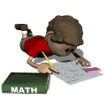
Math Review
Quarter 2

Slide 2
Models of Division
In order to divide multi-digit whole numbers, we learned these strategies:
  (You’ll see these on the test)
  Area Method/Rectangular Array – Draw rectangular arrays to break apart the dividend, working horizontally
  Expanded Notation – Breaking apart the dividend, working vertically
  (Additional strategies we learned)
  Forgiving Method
  Andros Method
  Standard Algorithm/Burger Method

Slide 3
Models of Division
Practice
  A student who helps in the school store suggests selling folders to students in packages of 6. How many packages of 6 folders can be made from 378 single folders?
  The parents who run the school store decide to buy a 9-pack of pencils for every student in the school to thank them for supporting the school store. If they purchase 2,259 pencils and all of them will be given to students, how many students will receive a pack of pencils?

Slide 4
Interpreting Remainders
When we have a remainder in a division problem, we have to figure out what to do with the leftovers. In order to figure out what to do with it, we have pay attention to the clues that are in the word problem. We then have to decide whether to…
  Round up or make another group
    There are 3 kids left over that won’t fit on a bus… We would have to get another bus, so they could go on the trip!
  Split up the extras into groups
    Kids are forming teams for a game. There are 4 students left over, so we just add them to other teams that have already been formed.
  Ignore the extras
    We are baking cookies, and there are 2 left over. We ignore these 2 cookies, so that everyone gets an equal amount.

Slide 5
Interpreting Remainders
Practice
Woodfield Elementary School held a can food drive. They collected 96 can goods. For delivery, each package needs to have 7 items in the bag.
How many packages of food can the school make?
Are there any leftovers?
If so, what happens to the remainders?

Slide 6
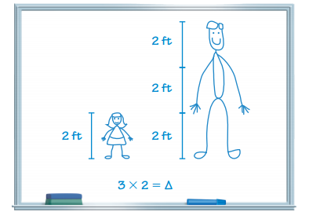
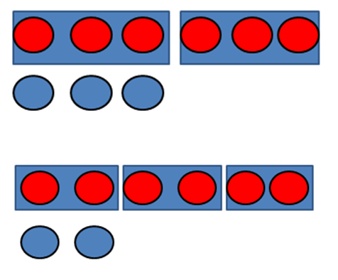
Multiplicative Comparisons
6 = 3 x 2
Can be represented as
6 is 2 times as many as 3 AND 6 is 3 times as many as 2.

Slide 7
Multiplicative Comparisons
Practice
Najee checked out 10 books from the library. Tariq checked out 3 times as many books as Najee. How many books did Tariq check out from the library?
Jamarcus checked out 15 books from the library. Melissa checked out 5 books from the library. How many times as many books did Jamarcus check out from the library compared to Melissa?

Slide 8
Multi-step problems
C - Circle the numbers. If they are written in word form, write the standard form above the words!
U - Underline the question. What are you being asked to solve?
B - Box any actions words! These key words will tell you what to do to solve the problem!
E - Evaluate what steps you should take to solve the problem! Eliminate any info you don’t need!
S - Solve and check! Does my answer make sense? How can I double-check my work?

Slide 9
Multi-step problems
Practice
Eleanor and Shelly are reading pages every night in their books.
Eleanor reads 6 pages each night.
Shelly reads 8 pages each night.
How many pages altogether will they read in one week?
2. Class A and Class B have 17 students each.
Class A has 6 girls.
Class B has twice as many girls as Class A.
How many students are girls from both classes?
3. Abigail and Jonah were at a birthday party and received a total of 48 favors in their bags.
They each received the same number of party favor bags.
Each bag had 8 favors.
How many party favor bags did they each receive?

Slide 10
Estimating in word problems
It is important to round your numbers BEFORE you complete any operations! Also, if the problem does not tell you which place to round to, you ALWAYS round to the largest place value.

Slide 11
Estimating in word problems
Practice
Randy works in the kitchen of a restaurant. Over the weekend, he washed a combined total of 931 large, medium, and small plates. If Randy washed 334 large plates and 275 medium plates, about how many small plates did he wash over the weekend?
Last quarter, Franklin Paper Company shipped 8,907 reams of white paper, 6,602 reams of colored paper, and 3,789 reams of recycled paper. About how many total reams of paper did the company ship?
A cell phone company has 3,319 customers in Australia and 6,324 customers in other countries. In total, about how many customers does it have?

Slide 12
Types of lines
Line
Line Segment
Ray
Parallel
Perpendicular

Slide 13
Types of lines
Practice
Dogwood Street
Name two roads that are parallel. How do you know they are parallel?
Name two roads that are perpendicular. How do you know they are perpendicular?
Elm Blvd.
Oak Street
Oak Avenue
Birch Street
Maple Street

Slide 14
Types of Angles
Acute Angles
  Less than 90 °
    1 ° - 89 °
Right Angles aka Perpendicular Lines
  Exactly 90 °
Obtuse Angles
  Larger than 90 °
    91 ° - 179 °
Straight Angles
  Exactly 180 °

Slide 15
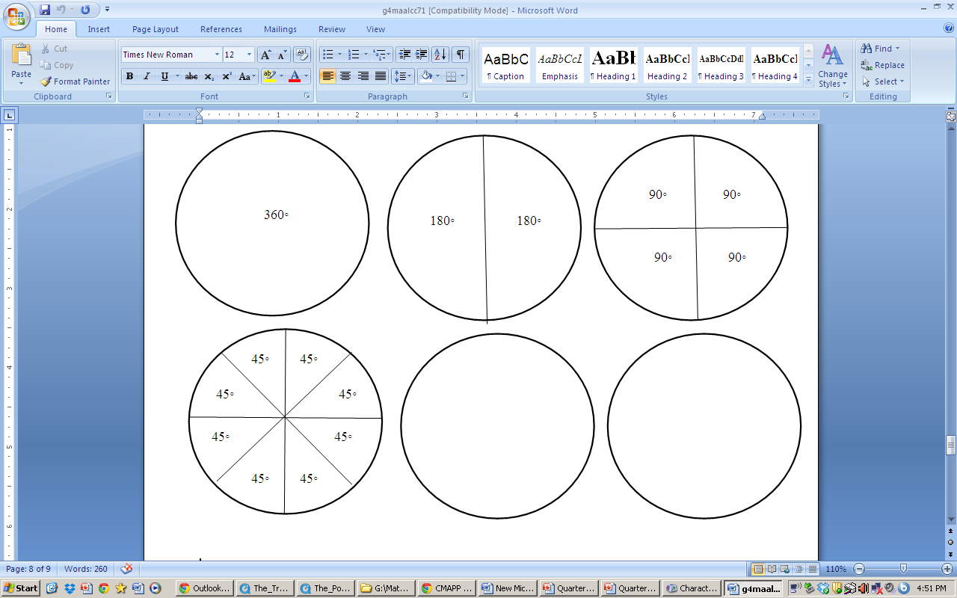
Angles within Circles
No matter how big or small a circle is,
it ALWAYS has 360°!
Half of a circle
is ALWAYS 180°!
A quarter (1/4) of a circle
is ALWAYS 90°!
An eight (1/8) of a circle
is ALWAYS 45°!

Slide 16
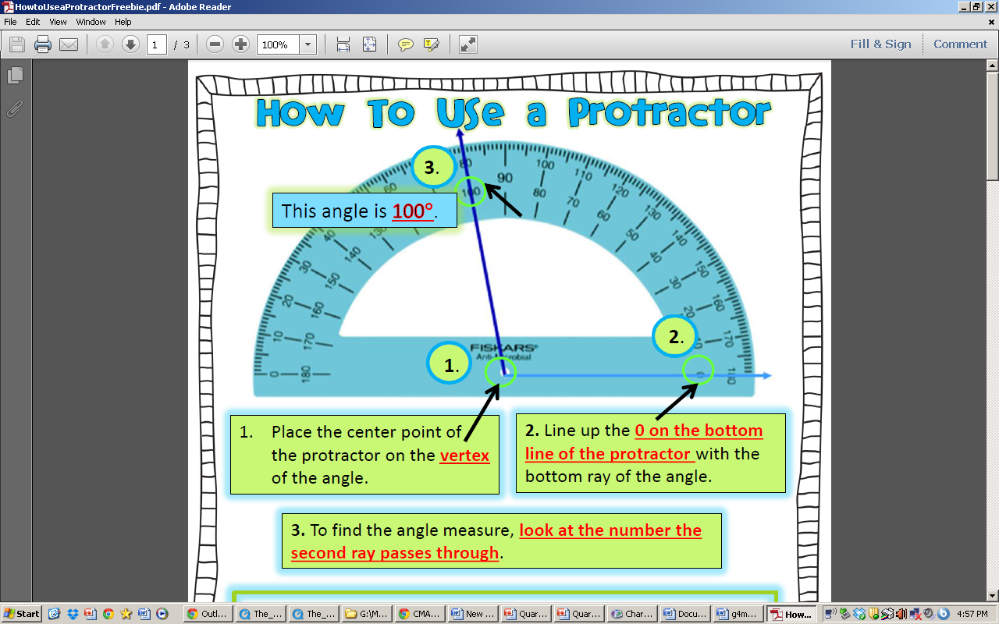
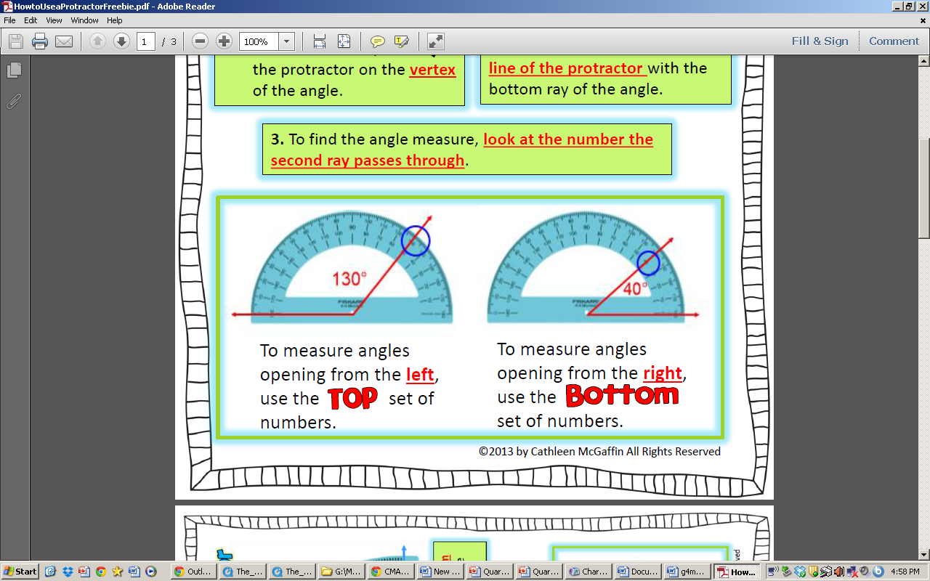
Measuring Angles with Protractors

Slide 17
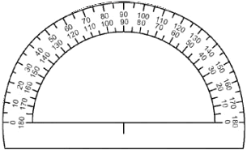
practice with Angles
What type of angle do you see?
What is the measure of the angle?
What type of angle do you see?
What is the measure of the angle?

Slide 18
Decomposing Angles
When we decompose angles, we break them down into two smaller angles.

Slide 19
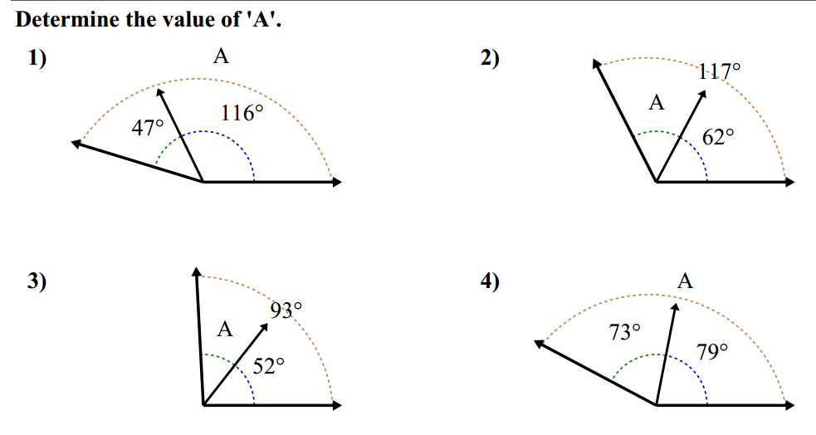
Decomposing Angles practice

Slide 20
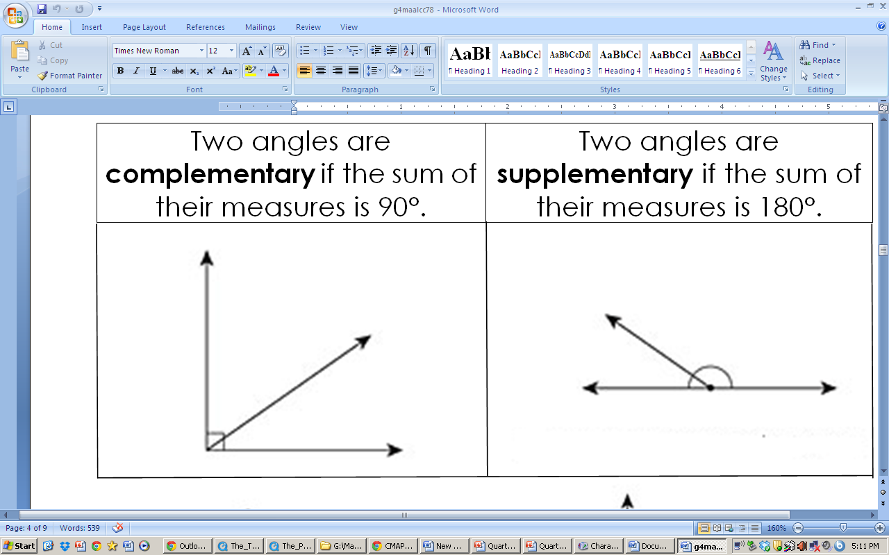
Complementary & supplementary angles

Slide 21
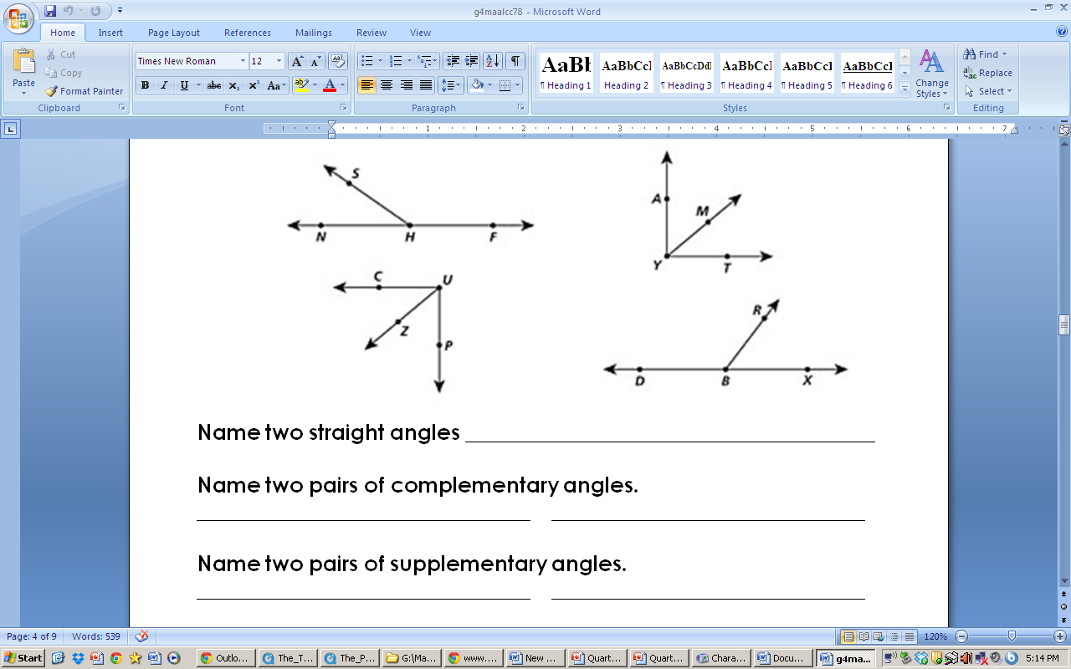
Complementary & supplementary angles
Practice

Slide 22
Shape Attributes
Every two-dimensional shape has various attributes. They can have parallel lines, perpendicular lines, and the all different types of angles.

Slide 23
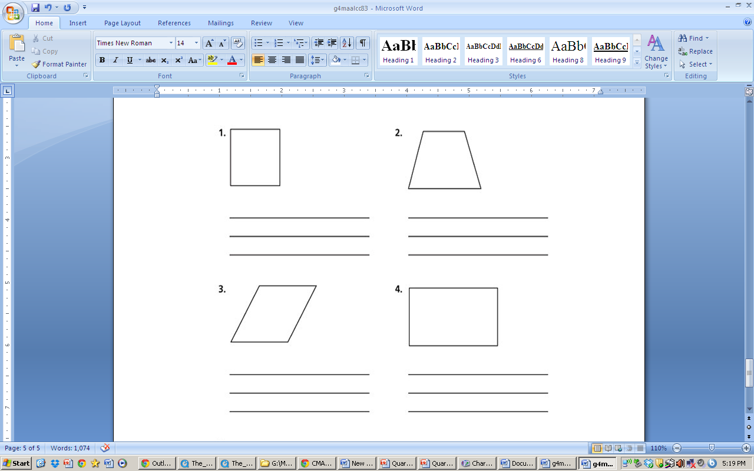
Shape Attributes
Practice
List as many attributes as you can for each shape.

Slide 24
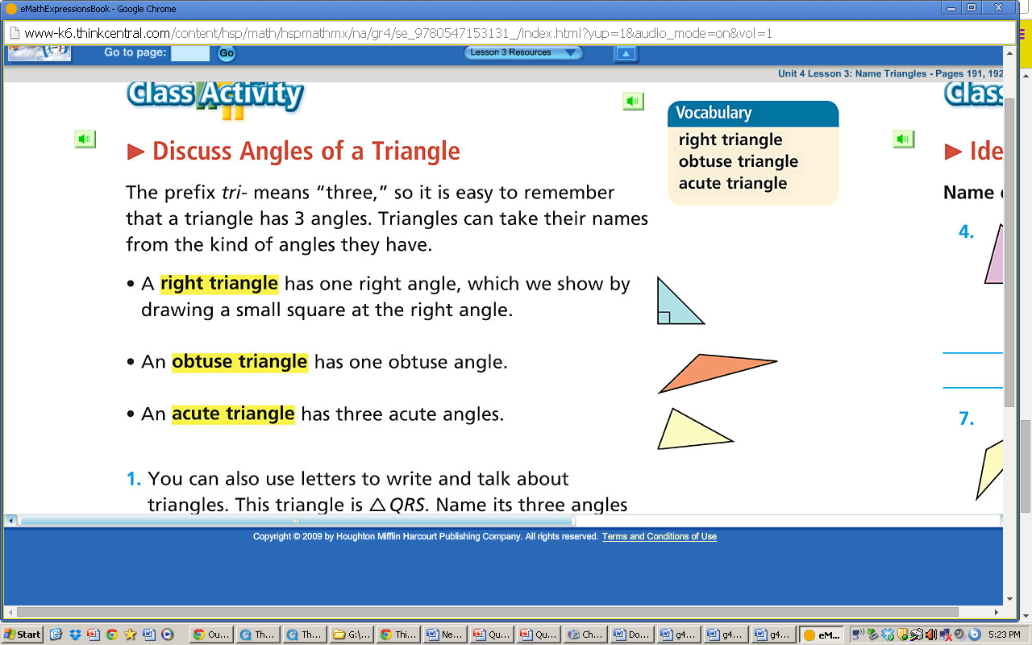
Types of Triangles

Slide 25
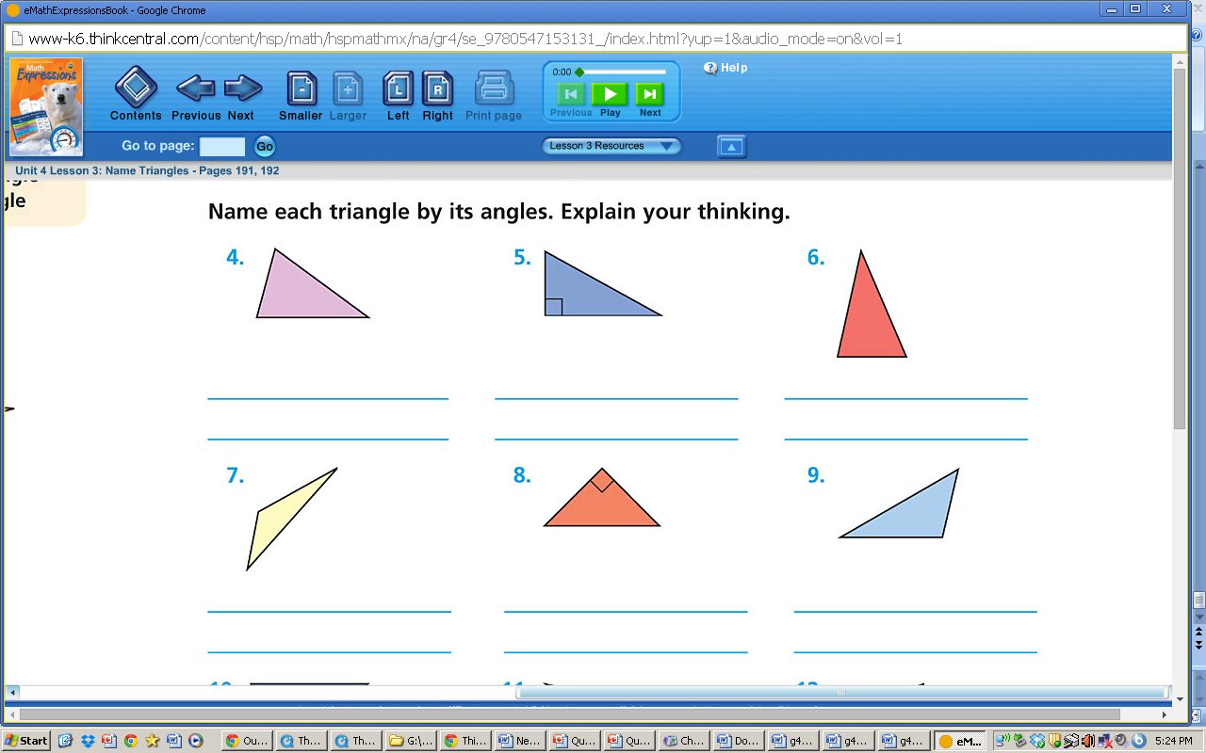
Types of Triangles
Practice

Slide 26
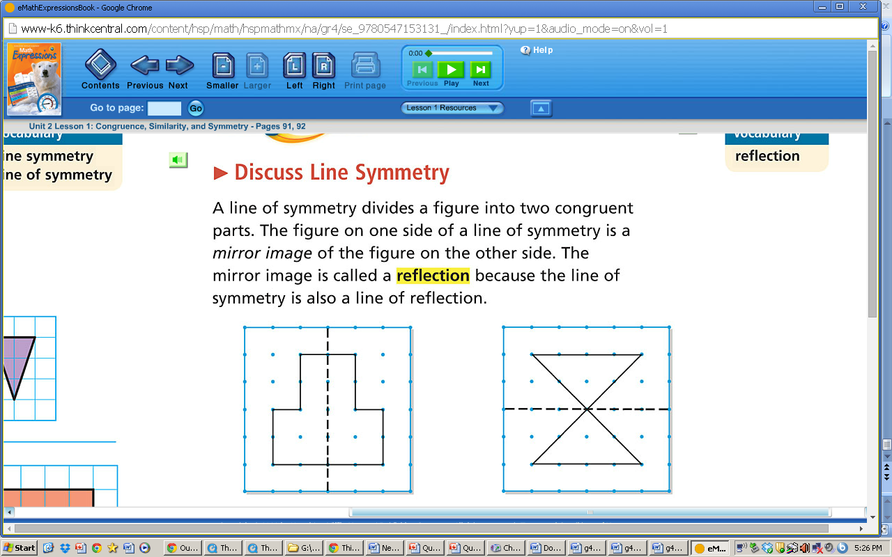
Lines of Symmetry

Slide 27
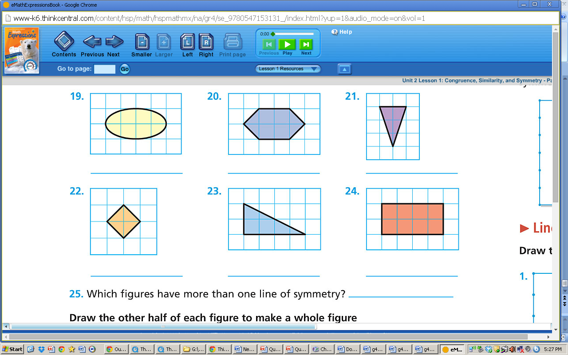
Lines of Symmetry
Practice
If possible, draw a line of symmetry for each shape.

