Slide 1
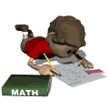
Math Review
Quarter 3

Slide 2
Area & Perimeter of Rectangles
Perimeter
The distance around a figure
Add up all of the sides
2L + 2W
L + L + W + W
Keywords
Fence Distance
Around Border
Area
The amount of space inside a figure
L x W
Keywords
Garden
Carpet/Rug/Tiles
Inside
Think ARRAYS!

Slide 3
Area & Perimeter of Rectangles
Mr. Davis has completed the rectangular fence around his garden using 40 feet. He wants to have more than 80 square feet of area inside the fence. Can you help him create a model of his garden? Is there more than one way?

Slide 4
Area & Perimeter of Complex Figures
Perimeter
Make sure you find all of the missing measurements before you find the perimeter!
Area
Make sure you break the complex figure down into squares or rectangles before finding the area!
http://www.youtube.com/watch?v=x1EZoifxmHE

Slide 5
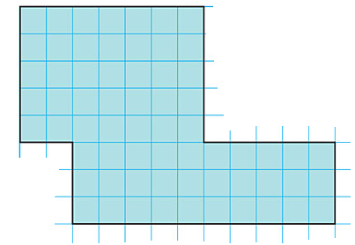
Area & Perimeter of Complex Figures
1. Find the dimensions of each side length of the complex figure above.
2. Label all the lengths and widths and use an equation to find the area and perimeter.
3. Record the perimeter and the area of the entire complex figure using correct units.
P = ___________________
A = ___________________

Slide 6
Geometric Patterns
Geometric patterns involve shapes or figures and can repeat, or grow!

Slide 7
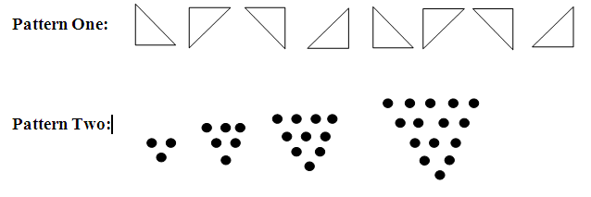
Geometric Patterns
In
Pattern | Features of the Pattern | Draw the next term
Pattern One
Pattern Two

Slide 8
Numerical Patterns
Numerical patterns involve numbers and can shrink, grow, or repeat!

Slide 9
Numerical Patterns
What is the pattern or pattern rule?
What would come next in the pattern?
What other features do you notice within this pattern?
Pattern One
4, 9, 14, 19, 24, 29, 34, 39, 44, 49
Pattern Two
3, 6, 9, 12, 15, 18, 21, 24, 27
Pattern Three
Pattern Rule: Start with 1 and multiply by 3 each time. Find the first 6 numbers in the pattern.
Pattern Four
You have 3 pencils. Each week you will get 4 more pencils. Find the first 6 numbers in the pattern.

Slide 10
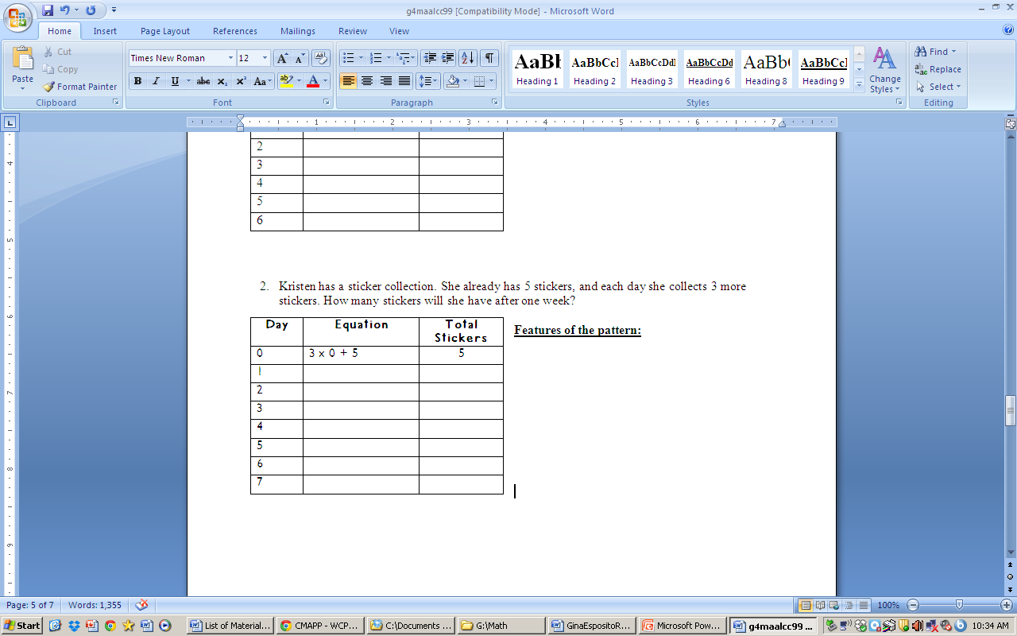
Numerical Patterns Using Tables
Kristen has a sticker collection. She already has 5 stickers, and each day she collects 3 more stickers. How many stickers will she have after one week?
Features of
the pattern:

Slide 11
Fraction Basics
Numerator – The number of parts that are being considered/the parts you’re looking at/the parts shaded (1/2)
Denominator – The number of parts in the whole (1/2)
Unit Fraction – A fraction showing one individual part of the whole (Example: ½)
Composing Fractions – Combining different parts of a whole to make a whole (Example: 8/8 = 3/8 + 5/8)
Decomposing Fractions – Taking a whole apart, into different parts (Example: 6/6 – 4/6 = 2/6)

Slide 12
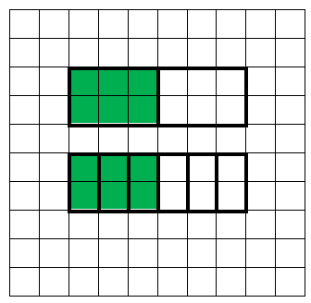
Equivalent Fractions
Equivalent fractions are two or more fractions that are the same size, but may have different numerators or denominators.
1/2 = 3/6

Slide 13
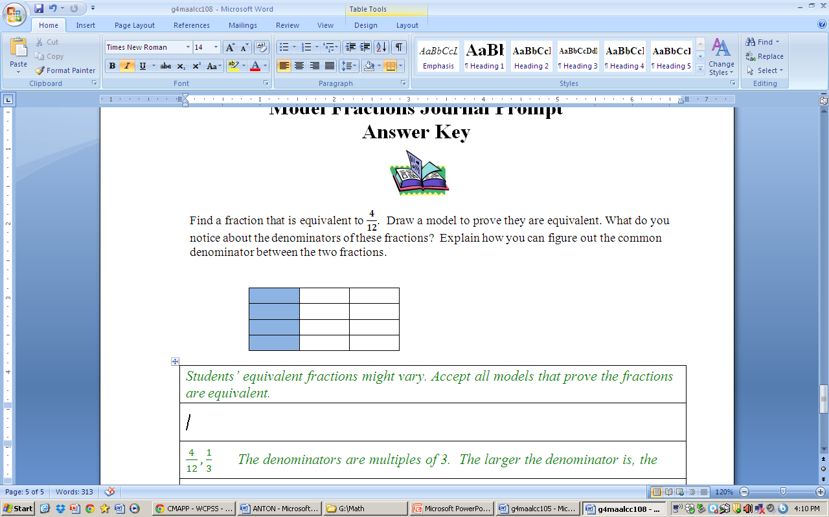
Equivalent Fractions with Models
Find a fraction that is equivalent to 4/12. Draw a model to prove they are equivalent. What do you notice about the denominators of these fractions?

Slide 14
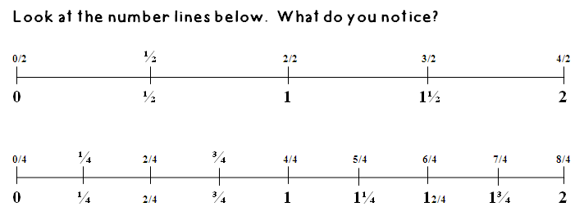
Equivalent Fractions On a Number Line

Slide 15
Mixed Numbers and Improper Fractions
Mixed Number – A whole number and a fraction. It shows a whole and it’s leftover parts
Improper Fraction – A fraction in which the numerator is greater than the denominator. It shows how many parts in all, which are greater than one whole.

Slide 16
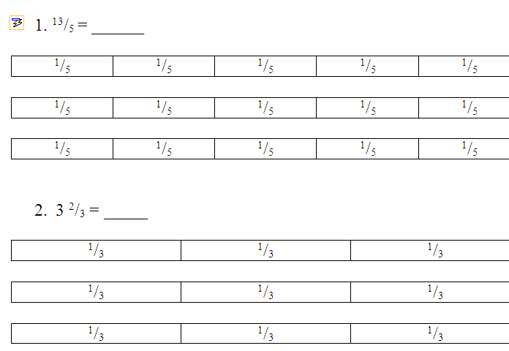
Equivalency Mixed Numbers and Improper Fractions

Slide 17
Equivalency with Mixed Numbers & Improper Fractions
Lexi walks her dog to and from the park each day of the week. They walk a total of ¹/₅ of a mile each day. How far does Lexi walk her dog in one week? Write your answer as a mixed number and an improper fraction.

Slide 18
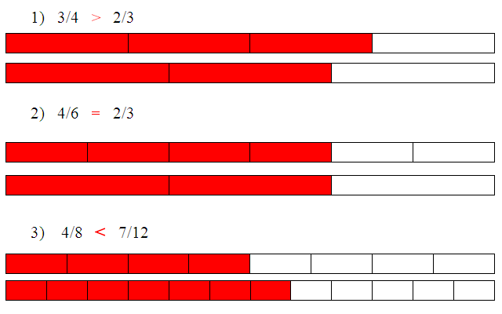
Comparing fractions Using Fraction Strips
In

Slide 19
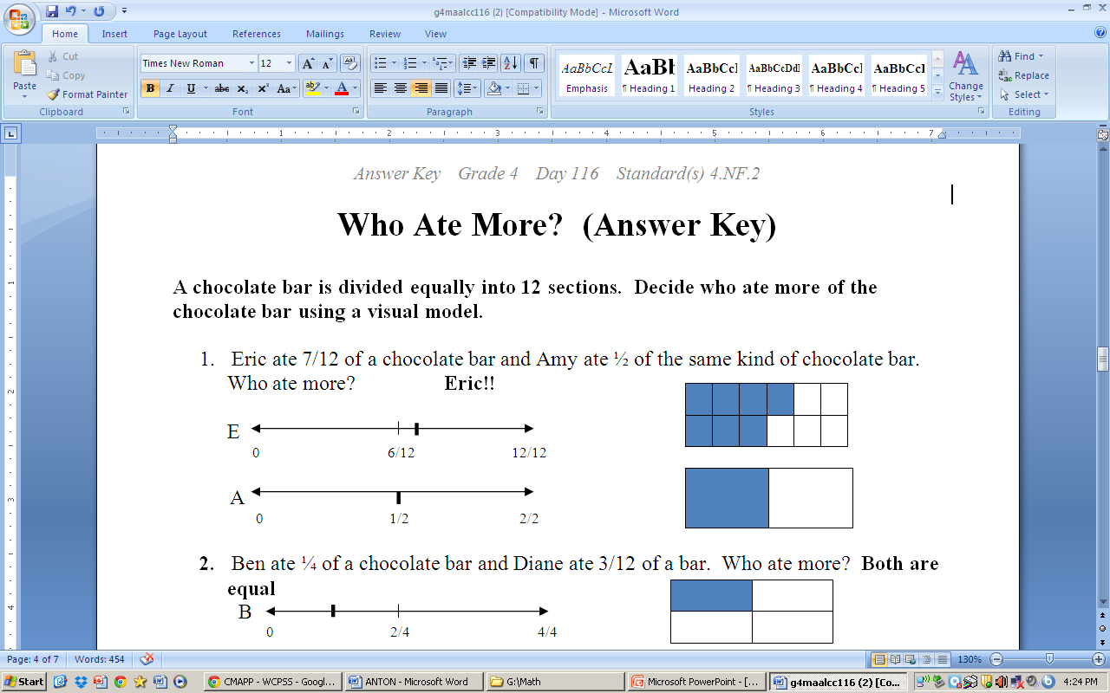
Comparing Fractions Using a Number Line
In

Slide 20
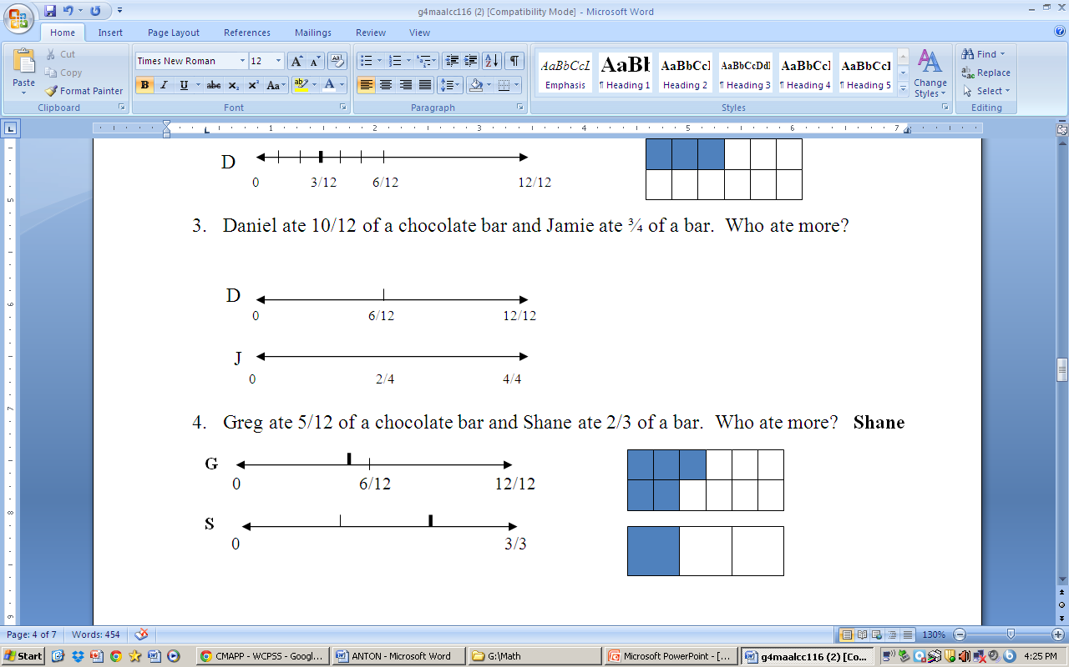
Comparing Fractions Using a Number Line

Slide 21
Adding & Subtracting Fractions With Like Denominators Using Fraction Bars
Caroline and Elijah shared a box of crayons. Caroline used 4/9 of the crayons and Elijah used 3/9 of the crayons. How many crayons did they both use? How many crayons were not used?

Slide 22
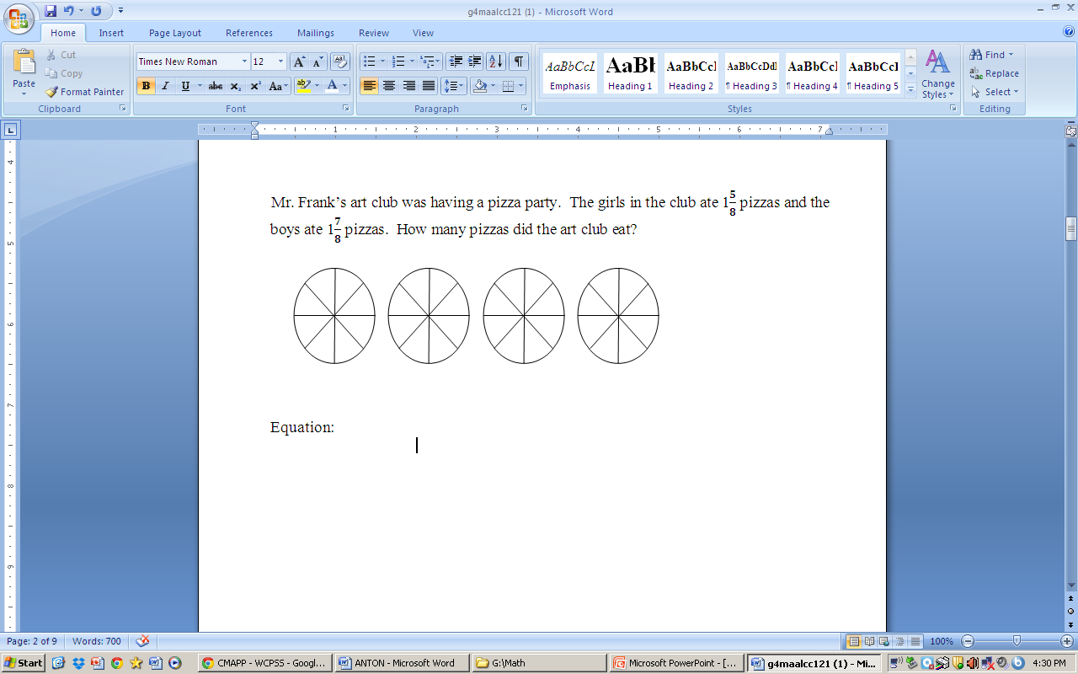
Adding & Subtracting Fractions With Mixed Numbers

Slide 23
Adding & Subtracting Fractions With Mixed Numbers
Blake and Caitlin were selling lemonade. On Monday, Blake sold 2 2/9 quarts of lemonade and Caitlin sold 2 6/9 quarts. On Tuesday, Blake sold 2 3/9 quarts of lemonade and Caitlin sold 3 3/9 quarts. Who sold more lemonade? How much more lemonade did they sell?

Slide 24
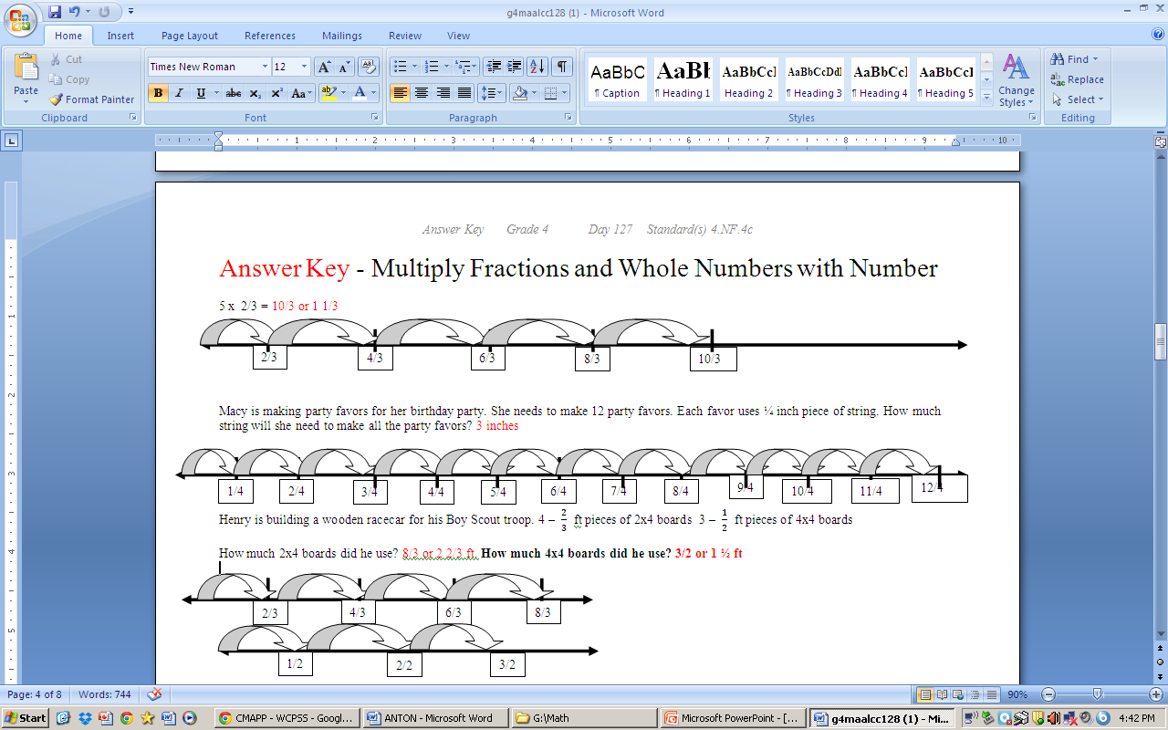
Multiplying Fractions With Number Lines

Slide 25
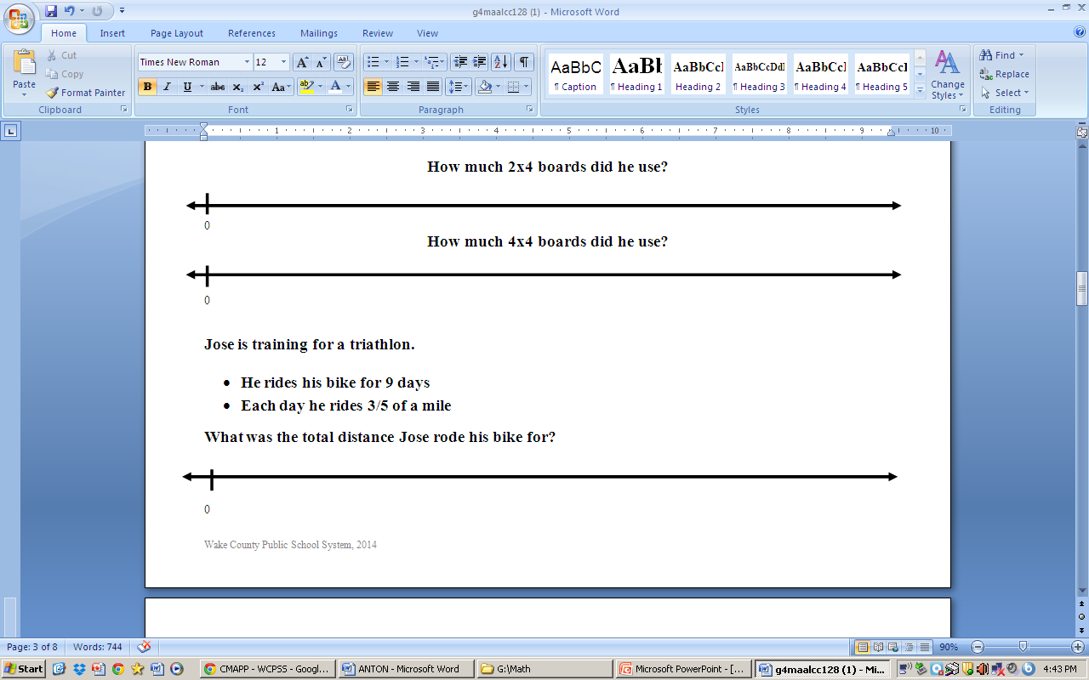
Multiplying Fractions With Number Lines

Slide 26
Multiplying Fractions With Repeated Addition
Mrs. Smith gave each student 1/3 of a candy bar. There were 12 students in her group.
How many total candy bars did Mrs. Smith give out?
1/3 + 1/3 + 1/3 + 1/3 + 1/3 + 1/3 + 1/3 + 1/3 + 1/3 + 1/3 + 1/3 + 1/3 = 12/3 or 4 candy bars
Or
12 x 1/3 = 4

